Slide 1
Presentation on
UNION AND INTERSECTION OF GRAPHS
Daya Sankhar Das, 23

Slide 2
The union of two graphs refers to combining the vertices and edges of the two graphs to form a new graph. The resulting graph contains all the vertices and edges from both graphs. Formally, let's consider two graphs G₁ = (V₁, E₁) and G₂ = (V₂, E₂) with vertex sets V₁ and V₂, and edge sets E₁ and E₂, respectively. The union of G₁ and G₂, denoted as G₁ ∪ G₂, is a graph defined as follows: The vertex set of G₁ ∪ G₂ is the union of V₁ and V₂, i.e., V₁ ∪ V₂. The edge set of G₁ ∪ G₂ is the union of E₁ and E₂, i.e., E₁ ∪ E₂. In the resulting graph G₁ ∪ G₂, there may be duplicate edges or self-loops if both G₁ and G₂ have such edges. However, it's common to assume that the resulting graph is simple, meaning it has no duplicate edges or self-loops. If duplicates or self-loops are not desired, you can remove them from the resulting graph.
UNION AND INTERSECTION OF GRAPHS
1) Union of graphs

Slide 3
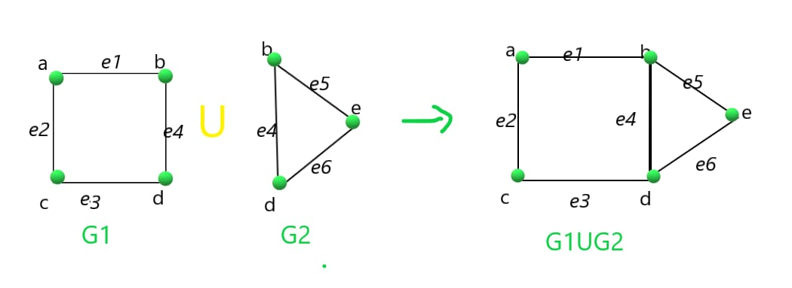
Figure of union of graph

Slide 4
2) Intersection of graphs
The intersection of two graphs refers to finding the common elements between them, specifically the common vertices and edges.
The resulting graph contains only the vertices and edges that exist in both input graphs.
Let's consider two graphs G₁ = (V₁, E₁) and G₂ = (V₂, E₂) with vertex sets V₁ and V₂, and edge sets E₁ and E₂, respectively. The intersection of G₁ and G₂, denoted
as G₁ ∩ G₂, is a graph defined as follows:
The vertex set of G₁ ∩ G₂ is the intersection of V₁ and V₂, i.e., V₁ ∩ V₂.
The edge set of G₁ ∩ G₂ is the intersection of E₁ and E₂, i.e., E₁ ∩ E₂.
In the resulting graph G₁ ∩ G₂, only the vertices and edges that are present in both G₁ and G₂ are retained. If a vertex or an edge is present in one graph but
not the other, it will not be part of the intersection graph.

Slide 5
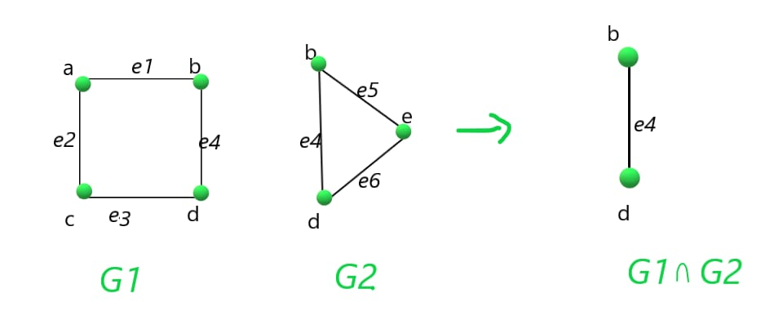
Figure of Intersection of graph

Slide 6


